Slide 1


AGE 316
MICROCOMPUTER SYSTEMS
LECTURE 10: ADVANCED INTERFACING (LCDs & DISPLAYS)
Dr. Kadeghe Fue
Department of Agricultural Engineering

Slide 2







Recap: The IO Journey
Logic
Input
Output
We learned to write the brain (C++ Code).
We learned to Sense (Sensors, ADC).
We learned to Act (Motors, LEDs).
Today: We learn to Show information to the user.

Slide 3


Why Displays?
The Solution
The Problem
Embedded Displays allow:
•
Real-time Data Monitoring (Temp, Moisture).
The Serial Monitor is great for debugging, but it requires a laptop attached via USB.
•
Status Updates (System ON/OFF).
•
User Menus and Settings.
A farmer in the field needs a standalone interface.
Temp: 24.5 C
Pump: ON

Slide 4







Common Arduino Displays
LCD (16x2)
OLED
7-Segment
Simple character display. Cheap, robust, low power. Best for text/numbers.
Organic LED. Sharp, high contrast, supports graphics/bitmaps. Small size.
Old school LEDs. Good for simple numbers (clocks, counters).

Slide 5
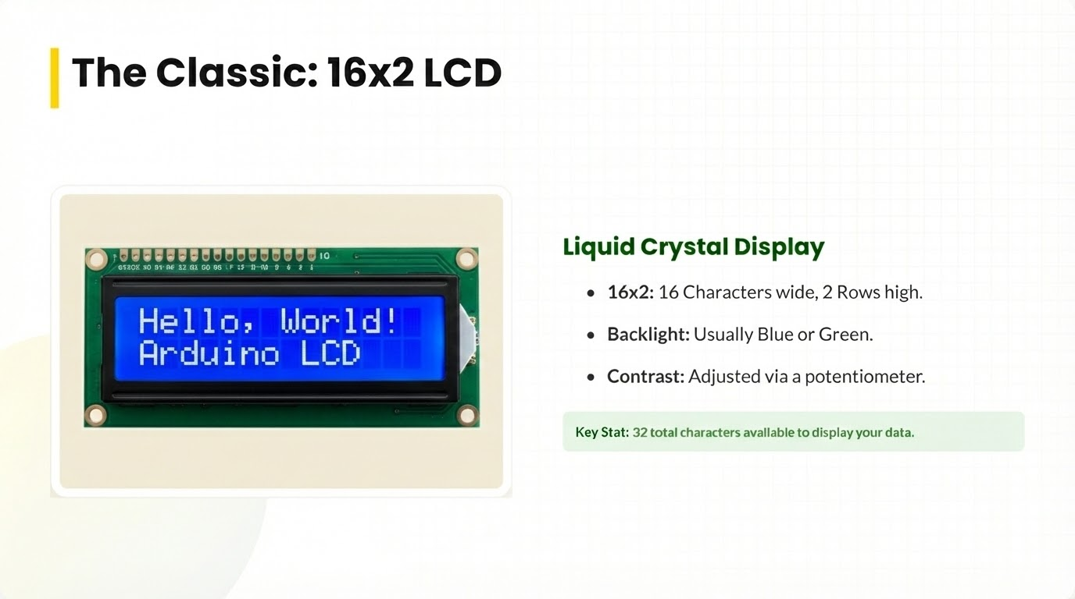

Slide 6
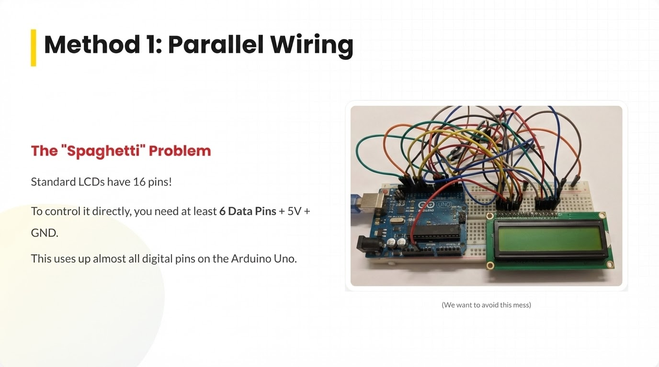

Slide 7
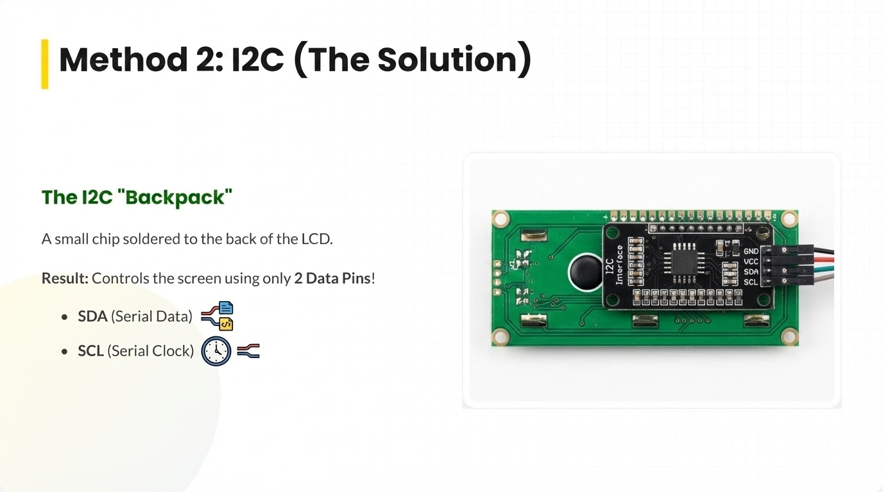

Slide 8







Concept: I2C Bus
Inter-Integrated Circuit (I2C) is a communication protocol.
2 Wires
Addresses
Master/Slave
Supports up to 127 devices on just two wires.
Each device has a unique ID (e.g., 0x27). The Arduino calls the ID to talk.
Arduino (Master) controls the sensors/displays (Slaves).

Slide 9


Wiring: Arduino to I2C LCD
LCD Pin | Arduino Uno Pin
GND | GND
VCC | 5V
SDA | A4
SCL | A5
Only 4 wires total!

Slide 10
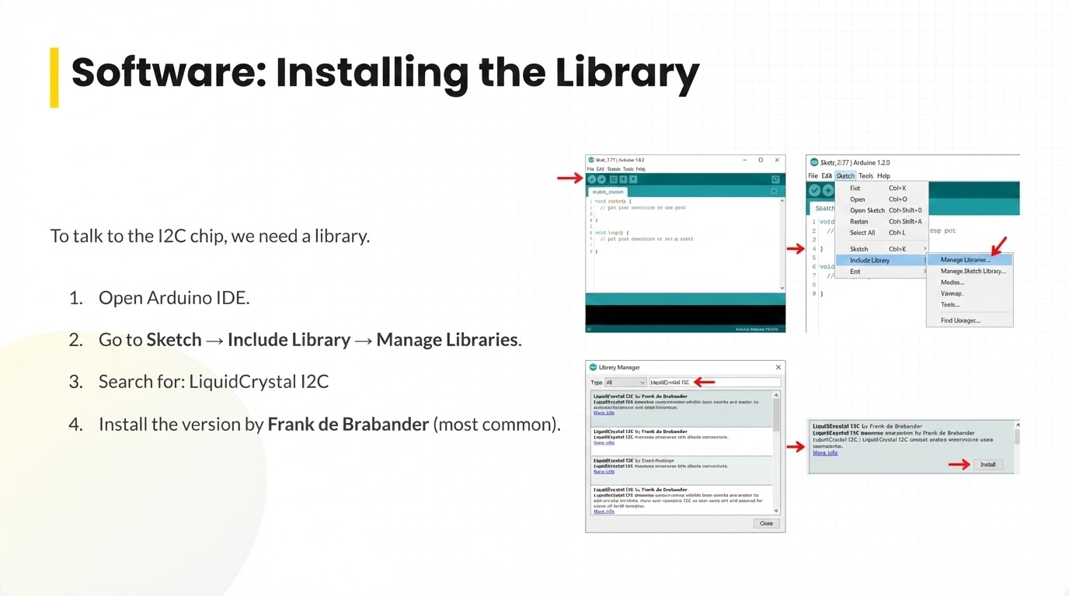

Slide 11

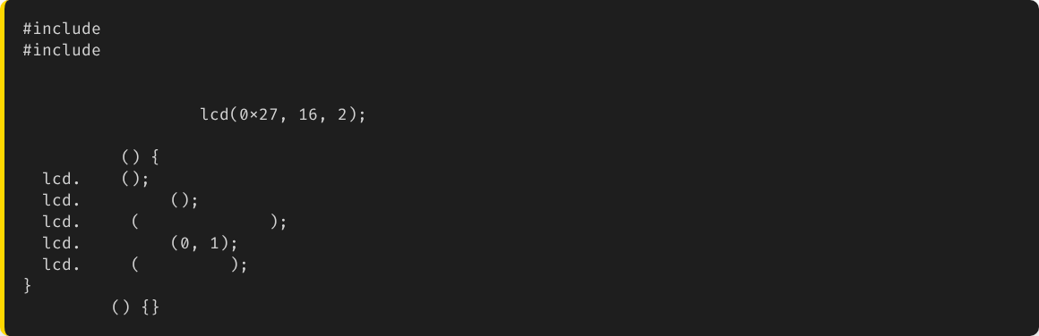
Code: Hello World
// Address 0x27, 16 chars, 2 lines
LiquidCrystal_I2C
void
setup
init
backlight
print
"Hello, SUA!"
setCursor
// Col 0, Row 1
print
"AGE 316"
void
loop

Slide 12




Key LCD Functions
lcd.setCursor(c, r)
lcd.clear()
lcd.backlight()
Moves the cursor to Column c and Row r.
Wipes the screen clean. Essential when updating numbers to avoid "ghost" digits.
Turns the light on. lcd.noBacklight() turns it off to save power.
Note: Counting starts at 0!

Slide 13

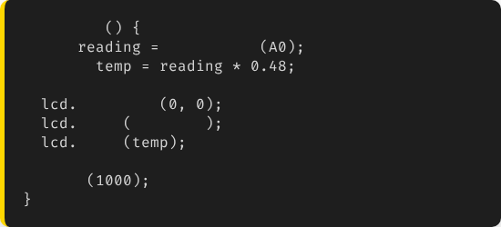

Project: Sensor Dashboard
Objective:
void
loop
int
analogRead
Display real-time temperature from a sensor.
float
// Fake math
setCursor
print
"Temp: "
Temp: 24 C
print
Status: OK
delay
// Update every sec

Slide 14
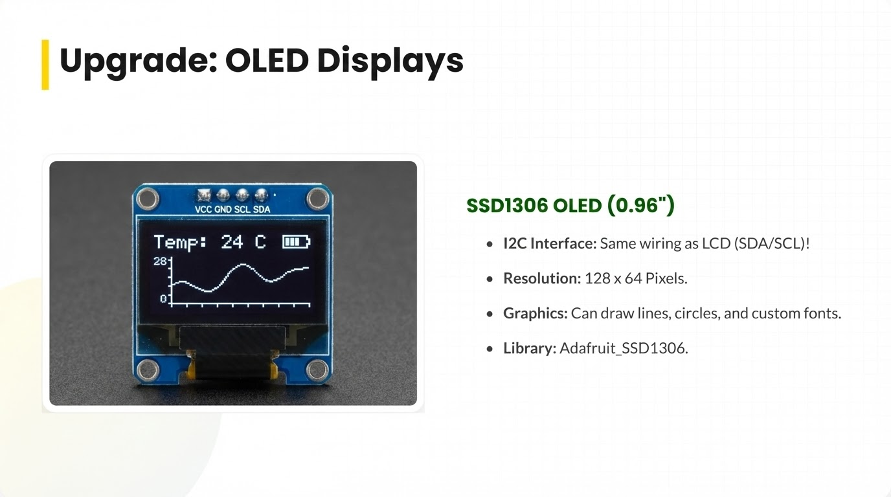

Slide 15

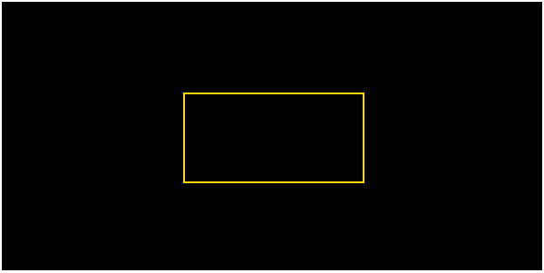
OLED: Coordinate System
Unlike the LCD (Rows/Cols), OLEDs use (X, Y) pixels.
(0,0) Origin
(127,0)
display.drawRect()
(0,63)
(127,63)

Slide 16







Summary
Visuals
I2C
Libraries
Displays allow standalone systems without a laptop.
Use I2C (SDA/SCL) to save pins. Requires the Wire library.
Use LiquidCrystal_I2C for text, Adafruit_SSD1306 for graphics.

Slide 17


Questions?
"The only stupid question is the one you don't ask."
Dr. Kadeghe Fue
Sokoine University of Agriculture

